Slide 1
Preanalytical concerns for canine cfDNA

Slide 2
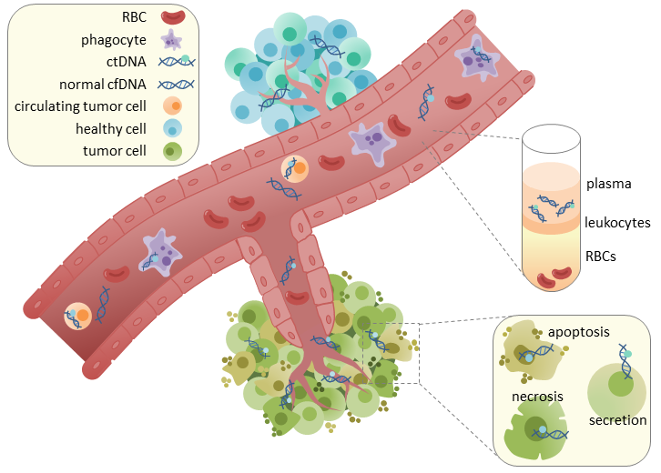
Cell-free DNA
Tumor
Notes:
Every time a cell dies some amount of DNA will be released, this amount is increased in tumors, due to increased rate of necrosis, hypoxia, unstable cells etc.
This tumor DNA will contain the variations found in the cancer cells and due to a very short half-life (some say less than 2 hours) it can be used as reliable marker for presence of tumor cells. So the idea is that you remove the tumor and mutations specific to the tumor is present in the cfDNA you know that there’s tumor cells left behind and adjuvant treatment is needed. Of course a certain tumor burden is needed before it’s detectable, but it should be more sensitive than the current modalities such as CT. It can also be used as a long-term follow up modality. Instead of having to do mammograms, CT’s and fine-needle aspirates, you can monitor the peripheral blood for tumor specific mutations and react earlier to any sign of relapse (due to the modality being more sensitive) especially if the metastasis is diffuse or internal.
Nogen siger 50 mio maligne celler er nok til at givve målbar ctDNA

Slide 3
ctDNA study - Aim
Proof-of-concept
Is cfDNA present in dogs
Is the amount stable over time
Is ctDNA is present in dogs with mammary tumors
Benign tumors
Carcinomas
Monitoring
Is ctDNA detectable before/at relapse in carcinomas
Notes:
I don’t necessarily expect the cfDNA level to be stable comparing T0 with the rest, as there’s the chance that the tumor elevate it.

Slide 4
ctDNA – Limitations
ctDNA undetectable
Absolute amount
Relative to blood sample-size
Methodology
Subclones – especially if targeted methods
At control
Patient is cured
Patients not monitored long enough

Slide 5
K2-EDTA blod
Hypotese 2-4
Centrifugér
16000 g
10 min
Hypotese 1
Hypotese 2
Hypotese 3
Hypotese 4
Frys ved -80˚C
Frys ved -80˚C
Gruppe 1
Gruppe 2
1 uge
Gruppe 1
Gruppe 2
1 uge
Centrifugér 16000 g
10 min
Centrifugér 12000 g
13 min
2 mdr
Frys ved -80˚C
I std. cryorør
Frys ved -80˚C
I LoBind rør
6 mdr
Mål koncentration
Mål koncentration
12 mdr
1 uge
1 uge
Frys ved -80˚C
18 mdr
Mål koncentration
Mål koncentration
Mål koncentration
1 uge
24 mdr
1 uge
Mål koncentration
Mål koncentration
Mål koncentration
1 uge
Mål koncentration
Mål koncentration
1 uge
Mål koncentration
Mål koncentration
Mål koncentration

